Slide 1
Mastering Git
A breakdown of steps taken
By Prakriti Ashwin
Updated Jan 7, 2026

Slide 2
Table of Contents
Part 1: Setup
Part 2: GIT repository and Push/Pull functions
Install GIT for Windows
Setting up GIT 2.51.2
GIT Username
Commit email address
Generate SSH address
Add SSH key to ssh-agent
Add SSH key to GitHub account
Creating a local repository
Saving it as a remote repository
Git Push
Git Pull

Slide 3
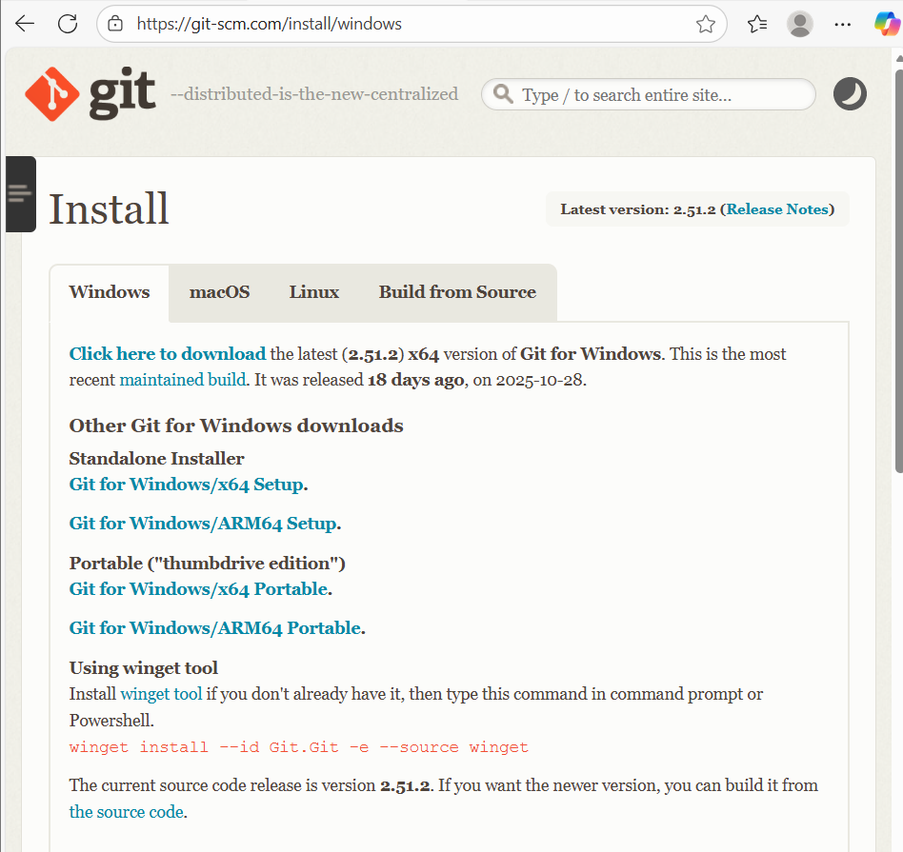
Part 1 Step 1: Install Git for Windows

Slide 4
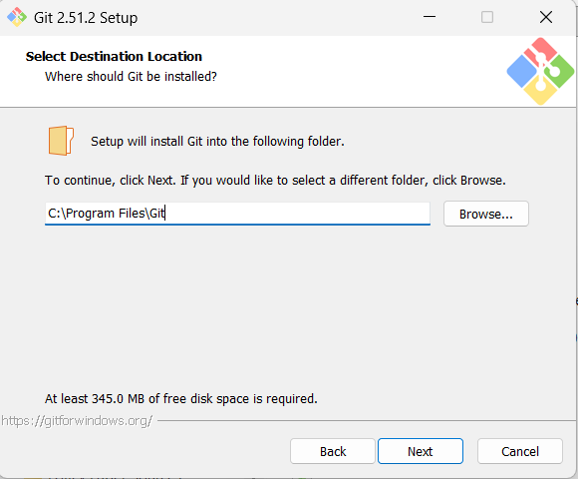
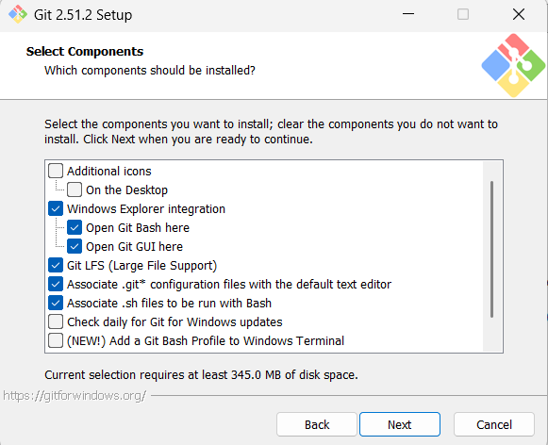
Step 2: Setting up Git 2.51.2
Destination Location
Components to install

Slide 5
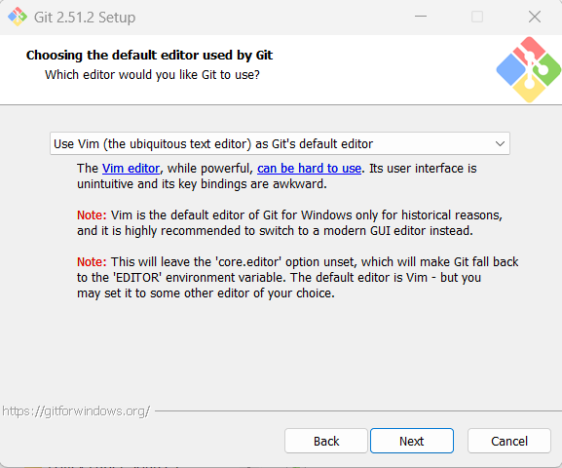
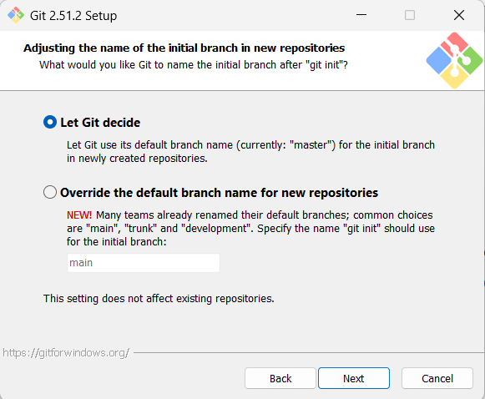
Step 2: Setting up Git 2.51.2
Default editor
Name of the initial branch in new repositories

Slide 6
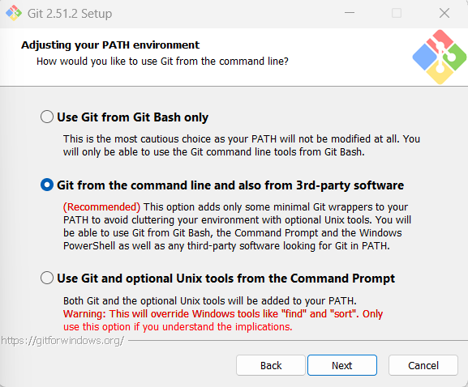
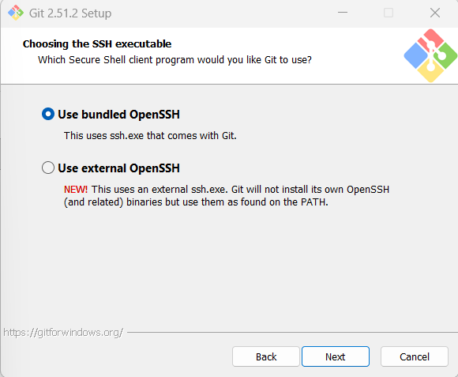
Step 2: Setting up Git 2.51.2
Adjusting PATH environment
SSH executable choice

Slide 7
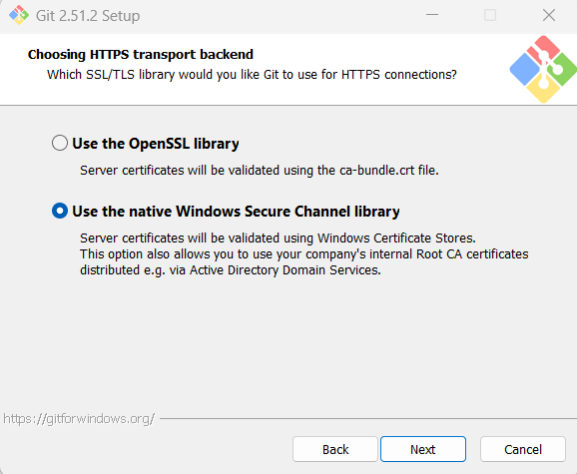
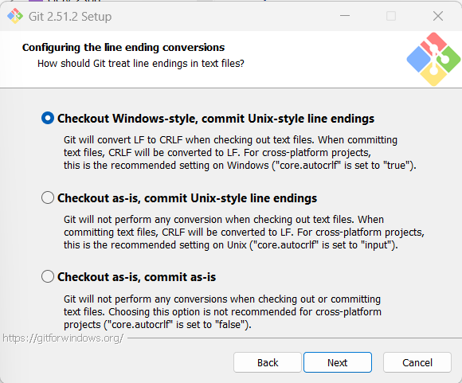
Step 2: Setting up Git 2.51.2
HTTPS transport backend
Line-ending conversions

Slide 8
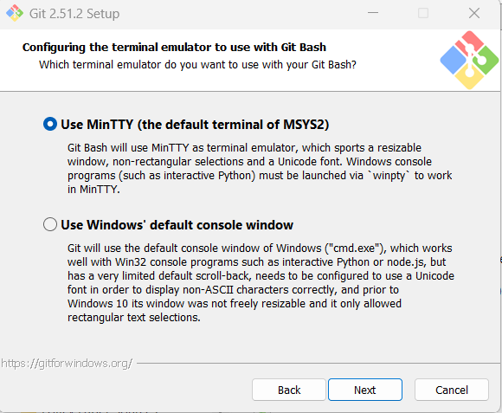
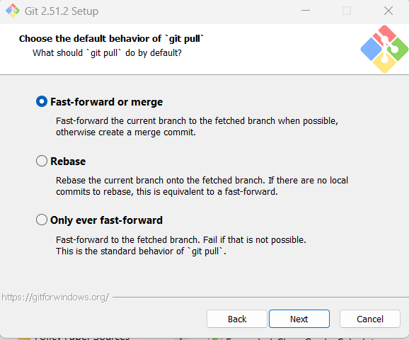
Step 2: Setting up Git 2.51.2
Terminal emulator to use with Git Bash
Git Pull default behavior

Slide 9
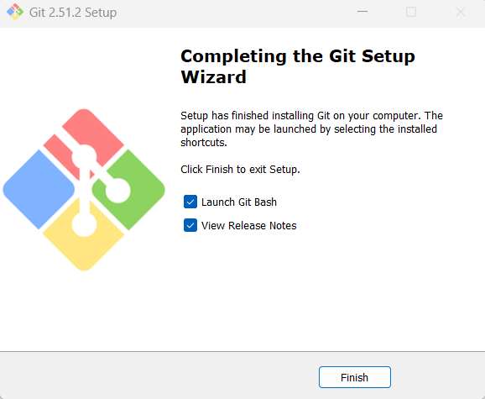
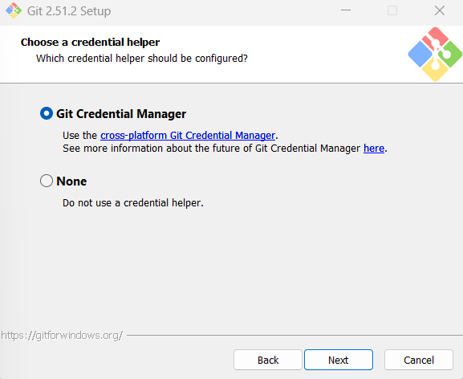
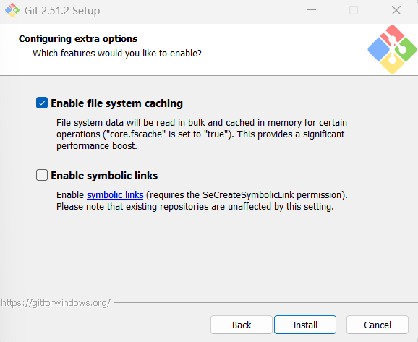
Step 2: Setting up Git 2.51.2
Credential helper choice
File system caching vs. symbolic links
Install -> Confirmation screen ----------->

Slide 10
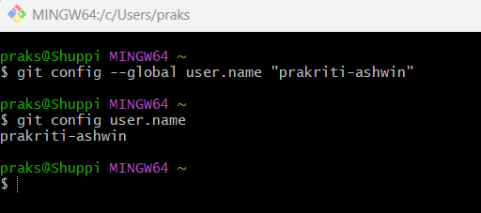
Step 3: Git username
Create and verify a global username (i.e. across all repositories)

Slide 11
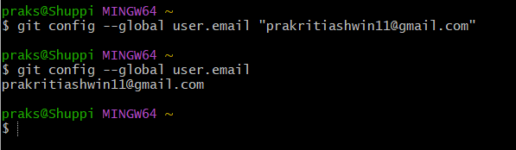
Step 4: Commit email address
Enter and verify a global email address (i.e. across all repositories) to link with Github

Slide 12
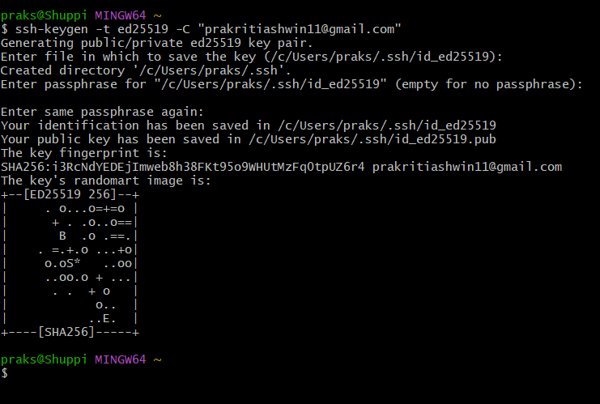
Step 5: Generating a new SSH key
First, we use the Ed25519 algorithm to create a new SSH key
When it prompts to enter a file in which to save the key, press Enter for the default location
It will ask for a passphrase

Slide 13
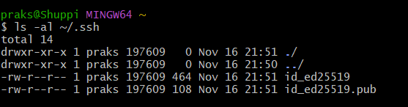
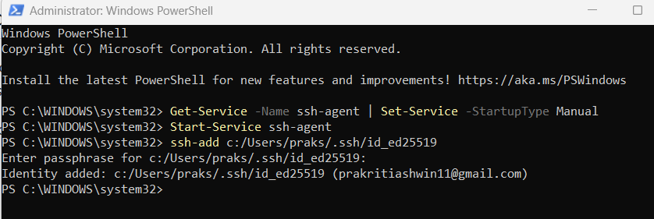
Step 6: Add SSH key to the ssh-agent
Verify existing SSH keys on Git Bash
Run Windows Powershell as Administrator to start SSH agent and add private key. Verify with passphrase.

Slide 14
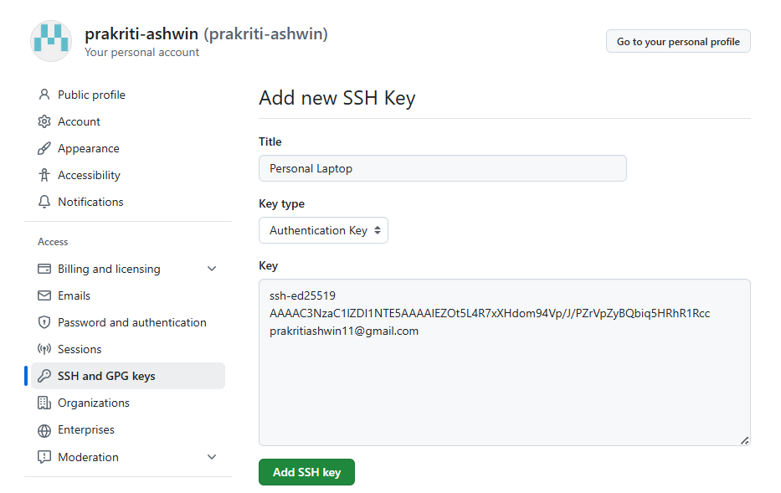

Step 7: Add SSH key to GitHub account
Copy the public key to the clipboard on Git Bash
GitHub: Settings -> Access -> SSH and GPG Keys -> Add New SSH Key
Paste content from clipboard and confirm

Slide 15
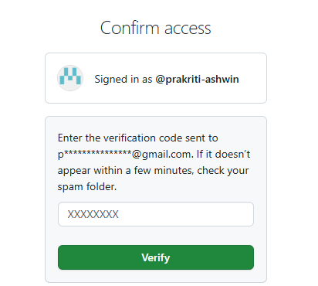
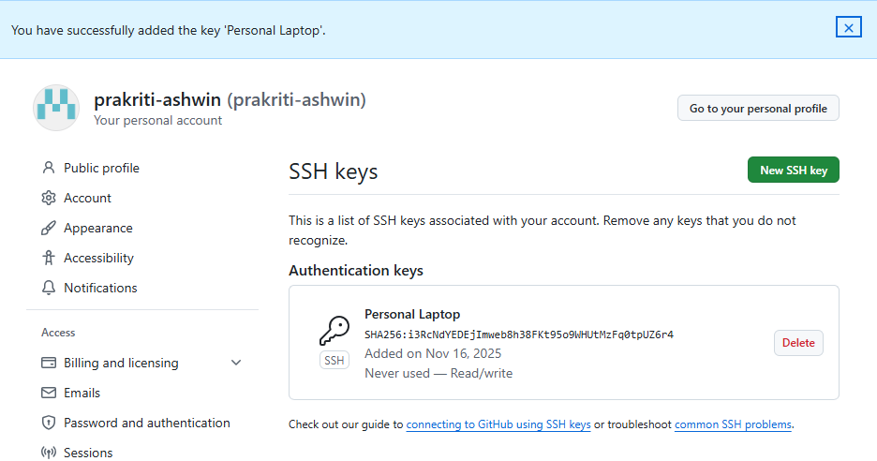
Step 7: Add SSH key to GitHub account
Verify email address
Ensure Authentication key is set up

Slide 16
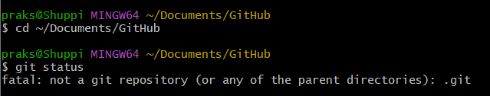
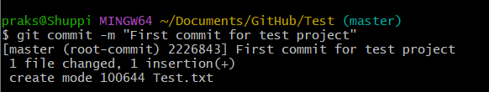
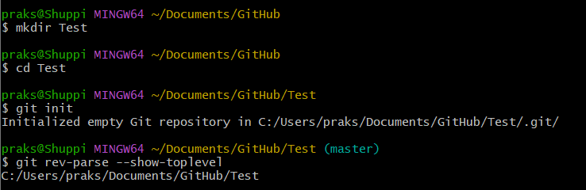
Part 2 Step 1: Creating a local repository
Check that there is no invisible repository in the chosen folder
Create a new folder to save the new repository
Initialize an empty repository (not saved online yet)

Slide 17
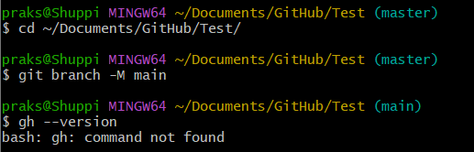
Step 2: Saving it as a remote repository
If (master) is displayed by default next to the save location, change it to main so that it is compatible with the Git website
Check if GitHub CLI (Command Line Interface) Is installed
Here, “bash: gh: command not found” means CLI is not installed, hence a remote repository should be created directly on the website

Slide 18
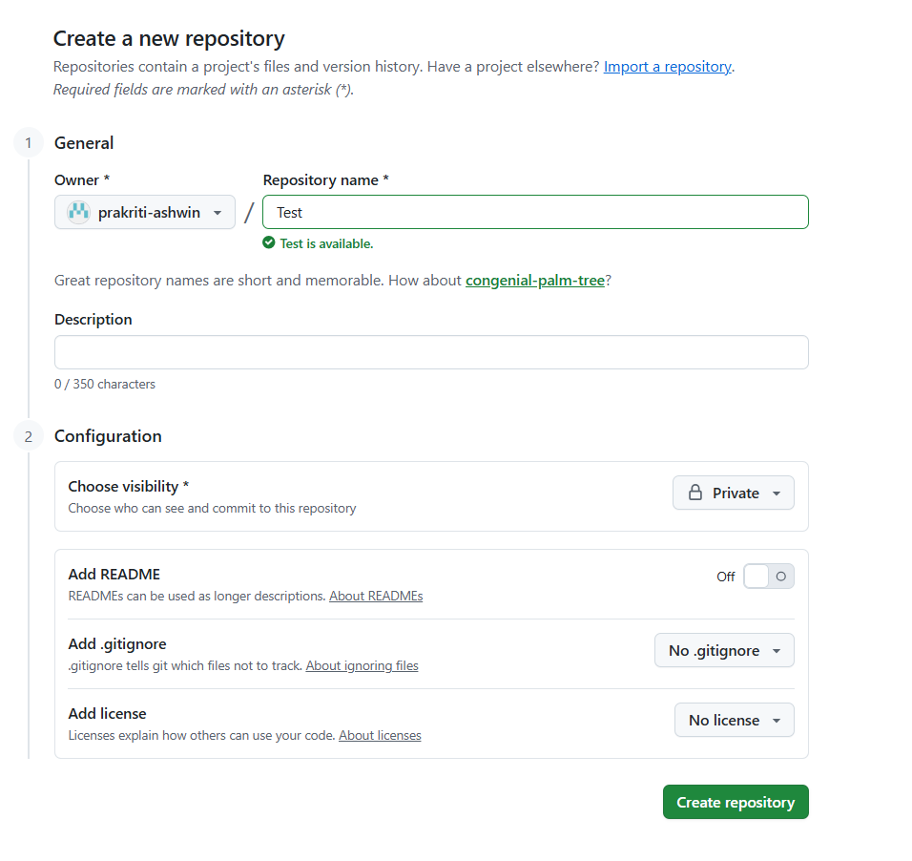
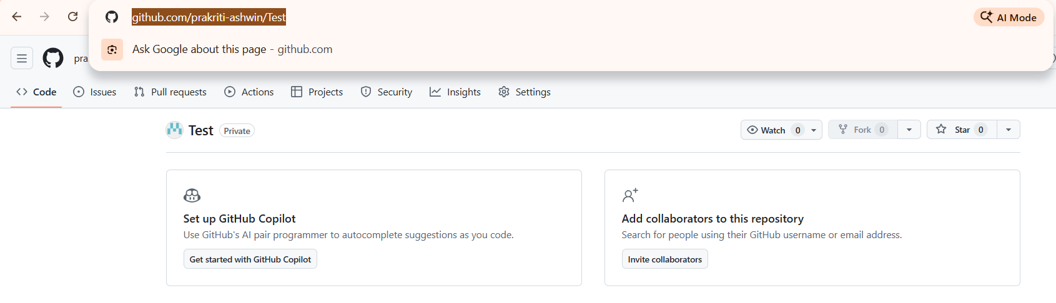
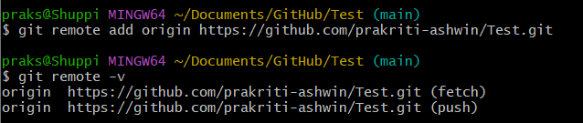
Step 2: Saving it as a remote repository
On the website, create a new repository
Copy the link address, paste in Git Bash

Slide 19
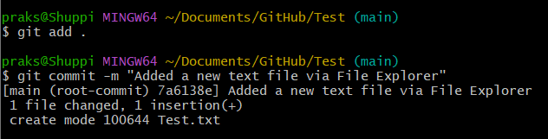
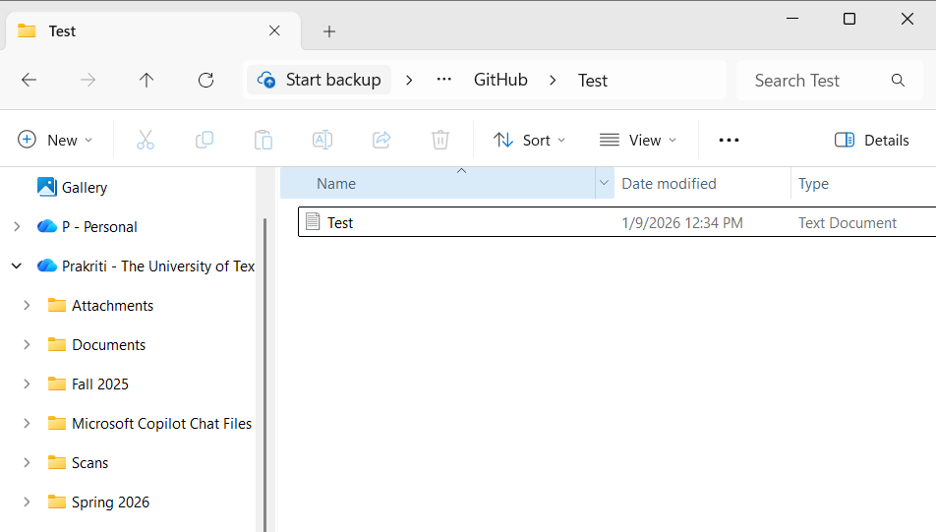
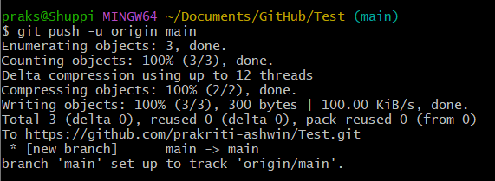
Step 3: Git Push
In the local repository (i.e. on your computer), create or save a file
In Git Bash, run git add . to register all files saved locally, then commit to “describe” changes, and finally push

Slide 20
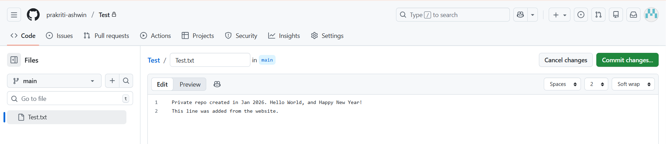
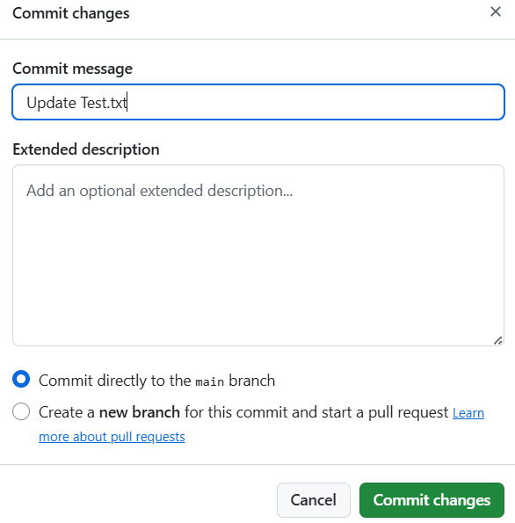
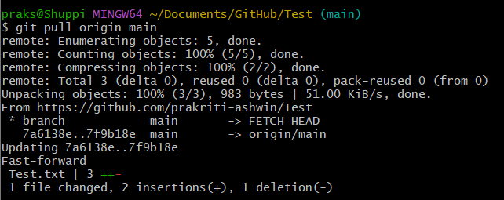
Step 4: Git Pull
Make some changes to a file on the website
Commit directly to the main branch to apply changes immediately to the main version
Run git pull

Slide 21
Thank you!

